Slide 1
Chapter 14: Transactions

Slide 2
Chapter 14: Transactions
Transaction Concept
Transaction State
Concurrent Executions
Serializability
Recoverability
Implementation of Isolation
Transaction Definition in SQL
Testing for Serializability.

Slide 3
Transaction Concept
A transaction is a unit of program execution that accesses and possibly updates various data items.
A transaction must see a consistent database.
During transaction execution the database may be temporarily inconsistent.
When the transaction completes successfully (is committed), the database must be consistent.
After a transaction commits, the changes it has made to the database persist, even if there are system failures.
Multiple transactions can execute in parallel.
Two main issues to deal with:
  Failures of various kinds, such as hardware failures and system crashes
  Concurrent execution of multiple transactions

Slide 4
ACID Properties
A transaction is a unit of program execution that accesses and possibly updates various data items.To preserve the integrity of data the database system must ensure:
Atomicity. Either all operations of the transaction are properly reflected in the database or none are.
Consistency. Execution of a transaction in isolation preserves the consistency of the database.
Isolation. Although multiple transactions may execute concurrently, each transaction must be unaware of other concurrently executing transactions. Intermediate transaction results must be hidden from other concurrently executed transactions.
  That is, for every pair of transactions T_{i} and T_{j}, it appears to T_{i} that either T_{j}, finished execution before T_{i} started, or T_{j} started execution after T_{i} finished.
Durability. After a transaction completes successfully, the changes it has made to the database persist, even if there are system failures.

Slide 5
Example of Fund Transfer
Transaction to transfer $50 from account A to account B:
  1. read(A)
  2. A := A – 50
  3. write(A)
  4. read(B)
  5. B := B + 50
  6. write(B)
Atomicity requirement — if the transaction fails after step 3 and before step 6, the system should ensure that its updates are not reflected in the database, else an inconsistency will result.
Consistency requirement – the sum of A and B is unchanged by the execution of the transaction.

Slide 6
Example of Fund Transfer (Cont.)
Isolation requirement — if between steps 3 and 6, another transaction is allowed to access the partially updated database, it will see an inconsistent database (the sum A + B will be less than it should be).
  Isolation can be ensured trivially by running transactions serially, that is one after the other.
  However, executing multiple transactions concurrently has significant benefits, as we will see later.
Durability requirement — once the user has been notified that the transaction has completed (i.e., the transfer of the $50 has taken place), the updates to the database by the transaction must persist despite failures.

Slide 7
Transaction State
Active – the initial state; the transaction stays in this state while it is executing
Partially committed – after the final statement has been executed.
Failed -- after the discovery that normal execution can no longer proceed.
Aborted – after the transaction has been rolled back and the database restored to its state prior to the start of the transaction. Two options after it has been aborted:
  restart the transaction; can be done only if no internal logical error
  kill the transaction
Committed – after successful completion.

Slide 8

Transaction State (Cont.)

Slide 9
Implementation of Atomicity and Durability
The recovery-management component of a database system implements the support for atomicity and durability.
The shadow-database scheme:
  assume that only one transaction is active at a time.
  a pointer called db_pointer always points to the current consistent copy of the database.
  all updates are made on a shadow copy of the database, and db_pointer is made to point to the updated shadow copy only after the transaction reaches partial commit and all updated pages have been flushed to disk.
  in case transaction fails, old consistent copy pointed to by db_pointer can be used, and the shadow copy can be deleted.

Slide 10

Implementation of Atomicity and Durability (Cont.)
Assumes disks do not fail
Useful for text editors, but
  extremely inefficient for large databases (why?)
  Does not handle concurrent transactions
Will study better schemes in Chapter 17.
The shadow-database scheme

Slide 11
Concurrent Executions
Multiple transactions are allowed to run concurrently in the system. Advantages are:
  increased processor and disk utilization, leading to better transaction throughput: one transaction can be using the CPU while another is reading from or writing to the disk
  reduced average response time for transactions: short transactions need not wait behind long ones.
Concurrency control schemes – mechanisms to achieve isolation; that is, to control the interaction among the concurrent transactions in order to prevent them from destroying the consistency of the database
  Will study in Chapter 15, after studying notion of correctness of concurrent executions.

Slide 12
Schedules
Schedule – a sequences of instructions that specify the chronological order in which instructions of concurrent transactions are executed
  a schedule for a set of transactions must consist of all instructions of those transactions
  must preserve the order in which the instructions appear in each individual transaction.
A transaction that successfully completes its execution will have a commit instructions as the last statement (will be omitted if it is obvious)
A transaction that fails to successfully complete its execution will have an abort instructions as the last statement (will be omitted if it is obvious)

Slide 13

Schedule 1
Let T₁ transfer $50 from A to B, and T₂ transfer 10% of the balance from A to B. Assume A =1000 and B = 2000.
A serial schedule in which T₁ is followed by T₂:
A = 855
B = 2145
A+B = 3000

Slide 14

Schedule 2
Let T₁ and T₂ be the transactions defined previously. The following schedule is not a serial schedule, but it is equivalent to Schedule 1.
A = 855
B = 2145
A+B = 3000
In Schedules 1, 2, the sum A + B is preserved.

Slide 15

Schedule 3
The following concurrent schedule does not preserve the value of (A + B).
A = 950
B = 2100
A+B = 3050
X

Slide 16
Serializability
Basic Assumption – Each transaction preserves database consistency.
Thus serial execution of a set of transactions preserves database consistency.
A (possibly concurrent) schedule is serializable if it is equivalent to a serial schedule. Different forms of schedule equivalence give rise to the notions of:
  1. conflict serializability
  2. view serializability
We ignore operations other than read and write instructions, and we assume that transactions may perform arbitrary computations on data in local buffers in between reads and writes. Our simplified schedules consist of only read and write instructions.

Slide 17
Conflicting Instructions
Instructions l_{i} and l_{j} of transactions T_{i} and T_{j} respectively, conflict if and only if there exists some item Q accessed by both l_{i} and l_{j}, and at least one of these instructions wrote Q.
1. l_{i} = read(Q), l_{j} = read(Q). l_{i} and l_{j} don’t conflict.
2. l_{i} = read(Q), l_{j} = write(Q). They conflict.
3. l_{i} = write(Q), l_{j} = read(Q). They conflict
4. l_{i} = write(Q), l_{j} = write(Q). They conflict
Intuitively, a conflict between l_{i} and l_{j} forces a (logical) temporal order between them.
  If l_{i} and l_{j} are consecutive in a schedule and they do not conflict, their results would remain the same even if they had been interchanged in the schedule.

Slide 18
Conflict Serializability
If a schedule S can be transformed into a schedule S´ by a series of swaps of non-conflicting instructions, we say that S and S´ are conflict equivalent.
We say that a schedule S is conflict serializable if it is conflict equivalent to a serial schedule

Slide 19


Conflict Serializability (Cont.)
Schedule 3 can be transformed into Schedule 6, a serial schedule where T₂ follows T₁, by series of swaps of non-conflicting instructions.
  Therefore Schedule 3 is conflict serializable.
Schedule 3
Schedule 6

Slide 20

Conflict Serializability (Cont.)
Example of a schedule that is not conflict serializable:
We are unable to swap instructions in the above schedule to obtain either the serial schedule < T₃, T₄ >, or the serial schedule < T₄, T₃ >.

Slide 21
View Serializability
Let S and S´ be two schedules with the same set of transactions. S and S´ are view equivalent if the following three conditions are met:
  1. For each data item Q, if transaction T_{i} reads the initial value of Q in schedule S, then transaction T_{i} must, in schedule S´, also read the initial value of Q.
  2. For each data item Q if transaction T_{i} executes read(Q) in schedule S, and that value was produced by transaction T_{j} (if any), then transaction T_{i} must in schedule S´ also read the value of Q that was produced by transaction T_{j} .
  3. For each data item Q, the transaction (if any) that performs the final write(Q) operation in schedule S must perform the final write(Q) operation in schedule S´.
As can be seen, view equivalence is also based purely on reads and writes alone.

Slide 22

View Serializability (Cont.)
A schedule S is view serializable it is view equivalent to a serial schedule.
Every conflict serializable schedule is also view serializable.
Below is a schedule which is view-serializable but not conflict serializable.
What serial schedule is above equivalent to?
Every view serializable schedule that is not conflict serializable has blind writes.

Slide 23
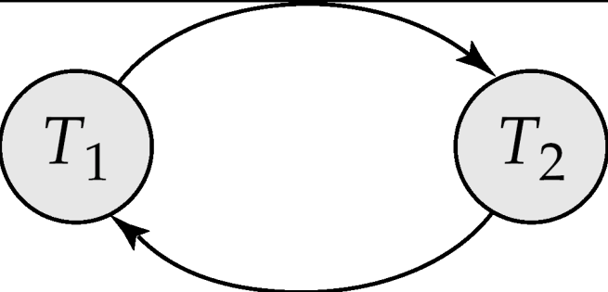
Testing for Serializability
Consider some schedule of a set of transactions T₁, T₂, ..., T_{n}
Precedence graph — a direct graph where the vertices are the transactions (names).
We draw an arc from T_{i} to T_{j} if the two transaction conflict, and T_{i} accessed the data item on which the conflict arose earlier.
We may label the arc by the item that was accessed.
Example 1
x
y

Slide 24
Example Schedule (Schedule A) + Precedence Graph
T₁ T₂ T₃ T₄ T₅
read(X)
read(Y)
read(Z)
read(V)
read(W)
read(W)
read(Y)
write(Y)
write(Z)
read(U)
read(Y)
write(Y)
read(Z)
write(Z)
read(U)
write(U)
T₁
T₂
T₄
T₃
T₅

Slide 25
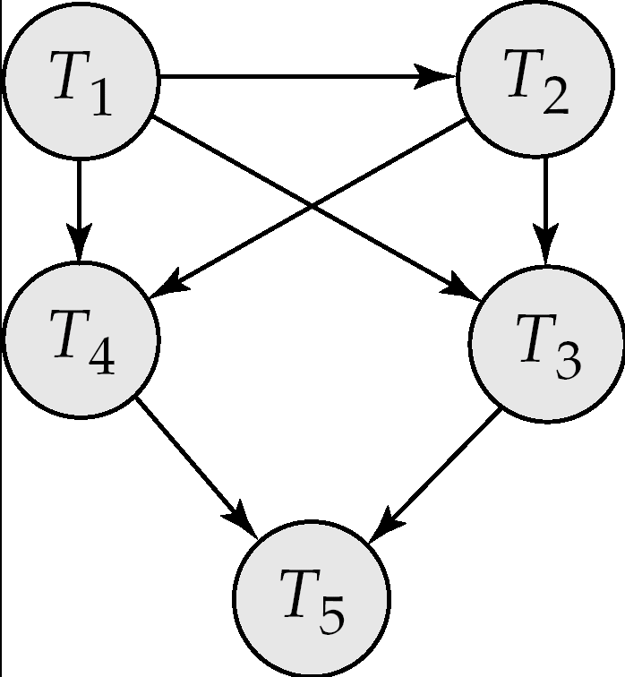
Test for Conflict Serializability
A schedule is conflict serializable if and only if its precedence graph is acyclic.
If precedence graph is acyclic, the serializability order can be obtained by a topological sorting of the graph.
  This is a linear order consistent with the partial order of the graph.
  For example, a serializability order for Schedule A would be
  T₅ → T₁ → T₃ → T₂ → T₄
    Are there others?

Slide 26
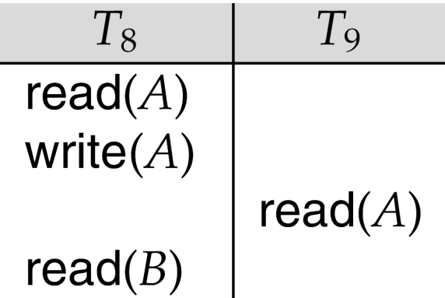
Recoverable Schedules
Recoverable schedule — if a transaction T_{j} reads a data item previously written by a transaction T_{i} , then the commit operation of T_{i} appears before the commit operation of T_{j}.
The following schedule (Schedule 11) is not recoverable if T₉ commits immediately after the read
If T₈ should abort, T₉ would have read (and possibly shown to the user) an inconsistent database state. Hence, database must ensure that schedules are recoverable.

Slide 27

Cascading Rollbacks
Cascading rollback – a single transaction failure leads to a series of transaction rollbacks. Consider the following schedule where none of the transactions has yet committed (so the schedule is recoverable)
If T₁₀ fails, T₁₁ and T₁₂ must also be rolled back.
Can lead to the undoing of a significant amount of work

Slide 28
Cascadeless Schedules
Cascadeless schedules — cascading rollbacks cannot occur; for each pair of transactions T_{i} and T_{j} such that T_{j} reads a data item previously written by T_{i}, the commit operation of T_{i} appears before the read operation of T_{j}.
Every cascadeless schedule is also recoverable
It is desirable to restrict the schedules to those that are cascadeless

Slide 29
Concurrency Control
A database must provide a mechanism that will ensure that all possible schedules are
  either conflict or view serializable, and
  are recoverable and preferably cascadeless
A policy in which only one transaction can execute at a time generates serial schedules, but provides a poor degree of concurrency
  Are serial schedules recoverable/cascadeless?
Testing a schedule for serializability after it has executed is a little too late!
Goal – to develop concurrency control protocols that will assure serializability.

Slide 30
Transaction Definition in SQL
Data manipulation language must include a construct for specifying the set of actions that comprise a transaction.
In SQL, a transaction begins implicitly.
A transaction in SQL ends by:
  Commit work commits current transaction and begins a new one.
  Rollback work causes current transaction to abort.
Levels of consistency specified by SQL-92:
  Serializable — default
  Repeatable read
  Read committed
  Read uncommitted

Slide 31
Assignment
14.15

Slide 32
Chapter 15 : Concurrency Control

Slide 33
Chapter 15: Concurrency Control
Lock-Based Protocols
Timestamp-Based Protocols
Validation-Based Protocols
Multiple Granularity
Multiversion Schemes
Insert and Delete Operations
Concurrency in Index Structures

Slide 34
Lock-Based Protocols
A lock is a mechanism to control concurrent access to a data item
Data items can be locked in two modes :
1. exclusive (X) mode. Data item can be both read as well as written. X-lock is requested using lock-X instruction.
2. shared (S) mode. Data item can only be read. S-lock is requested using lock-S instruction.
Lock requests are made to concurrency-control manager. Transaction can proceed only after request is granted.

Slide 35

Lock-Based Protocols (Cont.)
Lock-compatibility matrix
A transaction may be granted a lock on an item if the requested lock is compatible with locks already held on the item by other transactions
Any number of transactions can hold shared locks on an item,
  but if any transaction holds an exclusive on the item no other transaction may hold any lock on the item.
If a lock cannot be granted, the requesting transaction is made to wait till all incompatible locks held by other transactions have been released. The lock is then granted.

Slide 36
Lock-Based Protocols (Cont.)
Example of a transaction performing locking:
T₂: lock-S(A);
read (A);
unlock(A);
lock-S(B);
read (B);
unlock(B);
display(A+B)
Locking as above is not sufficient to guarantee serializability — if A and B get updated in-between the read of A and B, the displayed sum would be wrong.
A locking protocol is a set of rules followed by all transactions while requesting and releasing locks. Locking protocols restrict the set of possible schedules.

Slide 37

Pitfalls of Lock-Based Protocols
Consider the partial schedule
Neither T₃ nor T₄ can make progress — executing lock-S(B) causes T₄ to wait for T₃ to release its lock on B, while executing lock-X(A) causes T₃ to wait for T₄ to release its lock on A.
Such a situation is called a deadlock.
  To handle a deadlock one of T₃ or T₄ must be rolled back
  and its locks released.

Slide 38
Pitfalls of Lock-Based Protocols (Cont.)
The potential for deadlock exists in most locking protocols. Deadlocks are a necessary evil.
Starvation is also possible if concurrency control manager is badly designed. For example:
  A transaction may be waiting for an X-lock on an item, while a sequence of other transactions request and are granted an S-lock on the same item.
  The same transaction is repeatedly rolled back due to deadlocks.
T1 | T2 | T3 | T4
 | lock-S(A)
lock-X(A) | … | lock-S(A)
Wait… | … | … | lock-S(A)
Wait… | … | … | …

Slide 39
The Two-Phase Locking Protocol
This is a protocol which ensures conflict-serializable schedules.
Phase 1: Growing Phase
  transaction may obtain locks
  transaction may not release locks
Phase 2: Shrinking Phase
  transaction may release locks
  transaction may not obtain locks
The protocol assures serializability. It can be proved that the transactions can be serialized in the order of their lock points (i.e. the point where a transaction acquired its final lock).

Slide 40
The Two-Phase Locking Protocol (Cont.)
Two-phase locking does not ensure freedom from deadlocks

Slide 41

Partial Schedule Under Two-Phase Locking
Cascading roll-back is possible under two-phase locking.
To avoid this, follow a modified protocol called strict two-phase locking. Here a transaction must hold all its exclusive locks till it commits/aborts.
Rigorous two-phase locking is even stricter: here all locks are held till commit/abort. In this protocol transactions can be serialized in the order in which they commit.

Slide 42
Lock Conversions
Two-phase locking with lock conversions:
– First Phase:
  can acquire a lock-S on item
  can acquire a lock-X on item
  can convert a lock-S to a lock-X (upgrade)
– Second Phase:
  can release a lock-S
  can release a lock-X
  can convert a lock-X to a lock-S (downgrade)
This protocol assures serializability. But still relies on the programmer to insert the various locking instructions.

Slide 43

Incomplete Schedule With a Lock Conversion
T8:
  Read(a1)
  Read(a2)
  ……
  Read(an)
  Write(a1)
T9:
  Read(a1)
  Read(a2)
  Display(a1 + a2)
T8 and T9 can access a1 and a2 simultaneously.
If we employ the two-phase locking protocol, then T8 musk lock a1 in X-mode. Then any concurrent execution of both transactions amounts to a serial execution.

Slide 44
Deadlock Handling
Consider the following two transactions:
T₁: write (X) T₂: write(Y)
write(Y) write(X)
Schedule with deadlock
T₁
T₂
lock-X on X
write (X)
lock-X on Y
write (X)
wait for lock-X on X
wait for lock-X on Y

Slide 45
Deadlock Handling
System is deadlocked if there is a set of transactions such that every transaction in the set is waiting for another transaction in the set.
Deadlock prevention protocols ensure that the system will never enter into a deadlock state. Some prevention strategies :
  Require that each transaction locks all its data items before it begins execution (predeclaration).
  Impose partial ordering of all data items and require that a transaction can lock data items only in the order specified by the partial order.

Slide 46
More Deadlock Prevention Strategies
Following schemes use transaction timestamps for the sake of deadlock prevention alone.
wait-die scheme — non-preemptive
  older transaction may wait for younger one to release data item. Younger transactions never wait for older ones; they are rolled back instead.
  a transaction may die several times before acquiring needed data item
wound-wait scheme — preemptive
  older transaction wounds (forces rollback) of younger transaction instead of waiting for it. Younger transactions may wait for older ones.
  may be fewer rollbacks than wait-die scheme.

Slide 47
Deadlock prevention (Cont.)
Both in wait-die and in wound-wait schemes, a rolled back transactions is restarted with its original timestamp. Older transactions thus have precedence over newer ones, and starvation is hence avoided.
Timeout-Based Schemes :
  a transaction waits for a lock only for a specified amount of time. After that, the wait times out and the transaction is rolled back.
  thus deadlocks are not possible
  simple to implement; but starvation is possible. Also difficult to determine good value of the timeout interval.

Slide 48
Deadlock Detection
Deadlocks can be described as a wait-for graph, which consists of a pair G = (V,E),
  V is a set of vertices (all the transactions in the system)
  E is a set of edges; each element is an ordered pair T_{i} →T_{j}.
If T_{i} → T_{j} is in E, then there is a directed edge from T_{i} to T_{j}, implying that T_{i} is waiting for T_{j} to release a data item.
When T_{i} requests a data item currently being held by T_{j}, then the edge T_{i} T_{j} is inserted in the wait-for graph. This edge is removed only when T_{j} is no longer holding a data item needed by T_{i}.
The system is in a deadlock state if and only if the wait-for graph has a cycle. Must invoke a deadlock-detection algorithm periodically to look for cycles.

Slide 49


Deadlock Detection (Cont.)
Wait-for graph without a cycle
Wait-for graph with a cycle

Slide 50
Deadlock Recovery
When deadlock is detected :
  Some transaction will have to rolled back (made a victim) to break deadlock. Select that transaction as victim that will incur minimum cost.
  Rollback -- determine how far to roll back transaction
    Total rollback: Abort the transaction and then restart it.
    More effective to roll back transaction only as far as necessary to break deadlock.
  Starvation happens if same transaction is always chosen as victim. Include the number of rollbacks in the cost factor to avoid starvation

Slide 51
Assignment
A scheduled flight has 50 tickets. Agency one wants to book 10 tickets and agency two want to book 20 tickets. Please design a lock strategy to implement the concurrency control.
Agency one | Agency two
Read(A)
 | Read(A)
A=A-10
Write(A)
 | A=A-20
 | Write(A)

Slide 52
End of Chapter

